Slide 1



A Unit of Maharaja Education Trust®
Maharaja Institute of Technology Thandavapura
Approved by the AICTE & Affiliated to Visvesvaraya Technological University, Belagavi
Accredited by ISO 9001:2015 & ISO 21001:2018
NH766, Thandavapura, Nanjangud Taluk-571 302 , Mysore dist, Karnataka, India
21ECP76 Project Work
“Portable Ventilator”
Team Members
Guided By:
4MN21EC005:Bhoomika K S
Dept of ECE
MIT Thandavapura
Mrs. Subhashini R
Assistant Professor
Dept of ECE
MIT Thandavapura

Slide 2

Contents
Abstract
Objective
Literature Survey
Existing System
Proposed System
Block Diagram of proposed system
Module Description
Methodology
Implementation (Physical Model/Screen shot /Simulation)
Conclusion and Future enhancement

Slide 3


ABSTRACT
This project presents a low-cost ventilator using an Arduino Uno R4, MAX30100 heart rate and SpO₂ sensor, LCD display, MOSFET module, air pump, GSM module, and a buck converter.
The system continuously monitors SpO₂ and heart rate, displaying values on the LCD.
When SpO₂ drops below 100%, a fuzzy logic algorithm adjusts the air pump speed proportionally, increasing support as oxygen levels fall.
If SpO₂ goes below 90%, an alert is sent via GSM to notify medical staff. A buck converter provides stable power to the GSM module.
This system offers an affordable, automated solution for respiratory support in resource-limited settings.

Slide 4
OBJECTIVE
Primary objective of this project is to design and develop a low-cost, portable, and automated ventilator system that can provide automated respiratory assistance to patients with breathing difficulties. It will accomplish the following:
Continuously monitor the patient’s blood oxygen saturation (SpO₂) and heart rate using a non-invasive sensor.
Automatically adjust the airflow delivered by the diaphragm pump based on SpO₂ levels using fuzzy logic control for smooth and adaptive operation.
Alert caregivers or medical personnel through an SMS notification using a GSM module (SIM800L) in case of a critical drop in SpO₂ levels.
Display real-time health data on an LCD screen for continuous visual monitoring.
Operate reliably in resource-limited or emergency environments, with power supplied by a battery system regulated using a buck converter.

Slide 5
LITERATURE SURVEY
YEAR | PLACE | AUTHOR | TITLE | PROPOSED WORK
2022 | India | Rameshwar Bhaginath Kale, Shashank Kumar Singh. | DIY Ventilator using Arduino with Blood Oxygen Sensing for Covid Pandemic | The projected system consists of observe the breathing of the tolerant. The ceremony setup consists of a ventilator, bpm, switches, and toggles. This project was to develop a low-cost ventilator oppression one or two possible and easily obtain part in an extremely very prompt technique. The hardware strategies enclosed the developed trial of a model ventilator
2023 | India | Shereen Qisam Bless , Jameel Kadhim Abed, Mohannad Jabbar Mnati. | Developing a Portable Smart Ventilator: A Prototype that Balances Cost and Functionality | The project develops a portable ventilator that monitors vital signs using medical sensors, wirelessly transmits data to a cloud server, and displays real-time information on an integrated screen, aimed at improving outpatient care and managing severe respiratory cases.
2023 | India | Dr P Sivaranjani , Dr S Sasikala , Soumiya K , Subhashree M , Suriya S R . | IoT based Smart Ventilator for Automatic Oxygen Flow | The main concept is to build an oxygen ventilator that would pump the oxygen automatically according to the patients required level. The emergency level of the patient who needs oxygen ventilation will be different. In some case, the patient would be back to normal with normal flow of oxygen. But on the other hand, CPR has to be done. At times more force than normal, for a long time need to be applied to bring back the patients breathe again.

Slide 6
LITERATURE SURVEY
YEAR | PLACE | AUTHOR | TITLE | PROPOSED WORK
2023 | India | Ramakrishnan Raman, Amol Sapatnekar. | Smart Ventilators in Intensive Care: IoT-Connected Respiratory Support | The major goal of an IoT-connected smart ventilator system is to provide innovative, data-driven respiratory assistance in emergency and critical care situations. To provide better patient care, this system will continuously monitor and optimize breathing parameters, allow for rapid interventions, and improve the overall efficiency and efficacy of respiratory support without compromising patient comfort or safety.

Slide 7
EXISTING SYSTEM
Previous ventilator projects have focused on developing low-cost, portable solutions using platforms like Arduino and Raspberry Pi.
Many systems monitor basic vitals such as SpO₂ and heart rate, and recent advancements integrate IoT features for remote data transmission and real-time monitoring.
However, most existing models lack adaptive control, efficient data handling, and seamless patient feedback mechanisms.
.

Slide 8
PROPOSED SYSTEM
The proposed system is a low-cost, portable ventilator aimed at assisting patients with breathing issues, especially in resource-limited areas.
It uses an Arduino Uno R4 to control a MAX30100 sensor for monitoring SpO₂ and heart rate, displaying data on a 16x2 LCD.
Fuzzy logic adjusts an R385 pump’s speed based on SpO₂ levels, supplying airflow as needed.
If SpO₂ drops below 90%, a SIM800L module sends an emergency SMS.
The system runs on a dual-cell lithium-ion battery with a buck converter, making it ideal for emergency, rural, or home healthcare use..

Slide 9
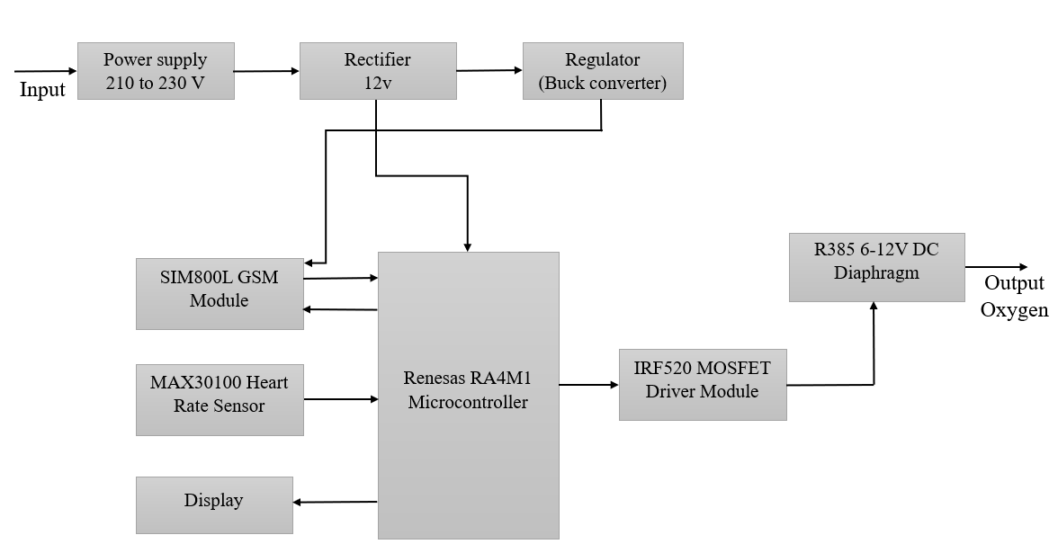
BLOCK DIAGRAM

Slide 10
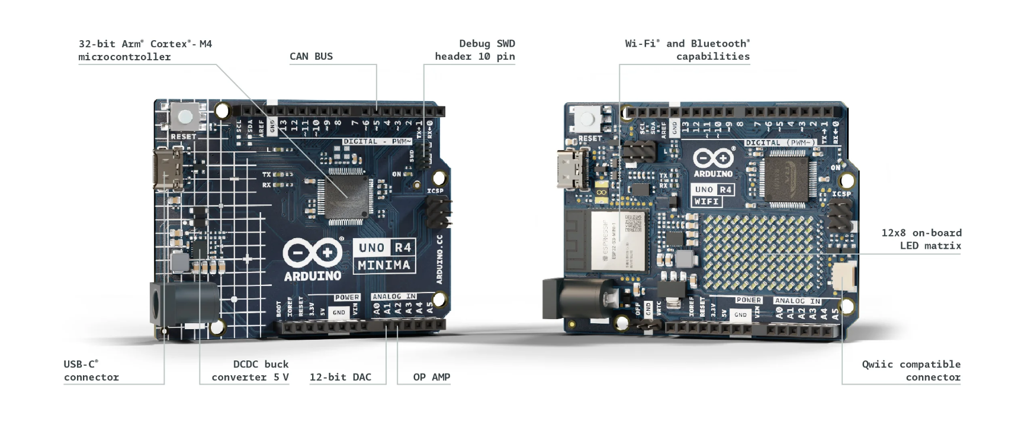
MODULE DESCRIPTION
Arduino Uno R4 Specifications
Board | Name | Arduino® UNO R4 WiFi
 | SKU | ABX00087
Microcontroller | Renesas RA4M1 (Arm® Cortex®-M4)
USB | USB-C® | Programming Port
Pins | Digital I/O Pins | 14
Pins | Analog input pins | 6
 | DAC | 1
 | PWM pins | 6
Communication | UART | Yes, 1x
 | I2C | Yes, 1x
 | SPI | Yes, 1x
 | CAN | Yes 1 CAN Bus
Power | Circuit operating voltage | 5 V (ESP32-S3 is 3.3 V)
 | Input voltage (VIN) | 6-24 V
 | DC Current per I/O Pin | 8 mA
Clock speed | Main core | 48 MHz
 | ESP32-S3 | up to 240 MHz
Memory | RA4M1 | 256 kB Flash, 32 kB RAM
 | ESP32-S3 | 384 kB ROM, 512 kB SRAM
Dimensions | Width | 68.85 mm
 | Length | 53.34 mm
Fig. Arduino Uno R4 .

Slide 11
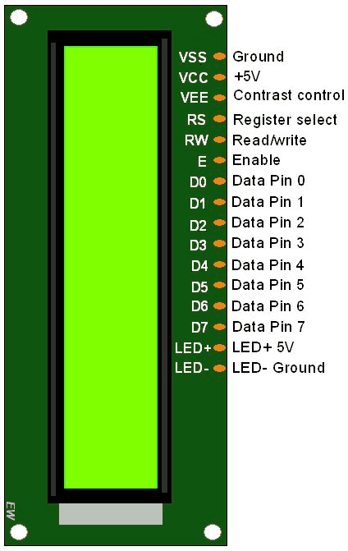
MODULE DESCRIPTION
16x2 LCD Display Specifications
Model Type: | LCD Display
Model No.: | JHD659 Y/YG
Resolution: | 16×4
Controller | SPLC780D
No. of Pins: | 16
Display Size (Inch): | 1604
Length (mm): | 87
Width (mm): | 60
Height (mm): | 12
Fig. 16x2 LCD Display

Slide 12
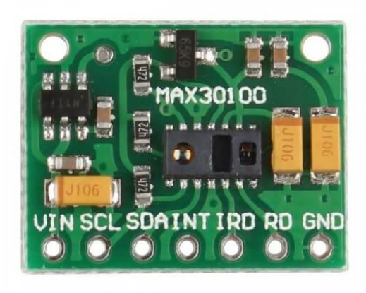
MODULE DESCRIPTION
MAX30100 Heart Rate Specifications
Item Type: | Sensor
Model Type: | Heart Rate Sensor, Pulse Oximeter
Operating Voltage (V): | 3.3 to 5
Model No.: | MAX30100
Interface: | I2C Interface
Wavelength (nm) | LED peak wavelength 660nm/880nm
Dimensions (mm) : | 0.5 x 8.5mm
Fig. MAX30100 Heart Rate .

Slide 13
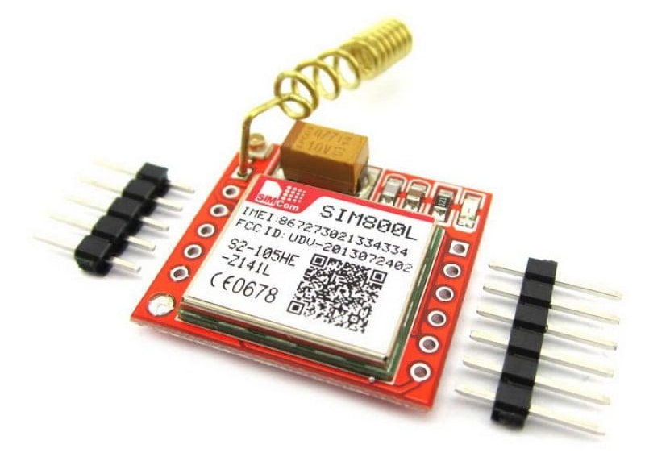
MODULE DESCRIPTION
SIM800L GSM Module Specifications
Item Type: | Module
Module Type | GPRS Module, GSM Module
Voltage Rating (VDC): | 3.7 to 4.2
Peak Current (A) | 2
Fig.SIM800L GSM Module.

Slide 14
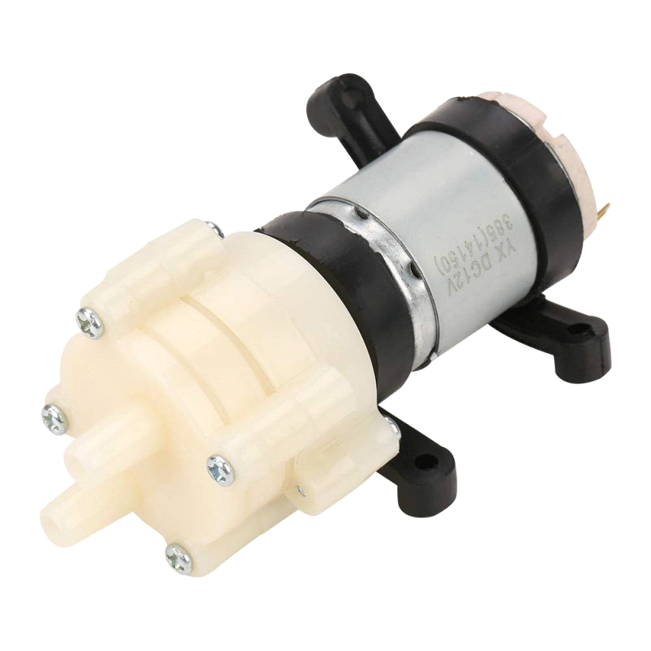
MODULE DESCRIPTION
R385 6-12V DC Diaphragm Specifications
Item Type: | Water Pump
Voltage Rating (V): | 6 to 12V DC
Operating Current (A): | 0.5 to 0.7
Suction Stroke Limit | 2M
Inner Diameter [ID] (mm) | 4
Outer Diameter [OD] (mm): | 8
Fig. R385 6-12V DC Diaphragm.

Slide 15
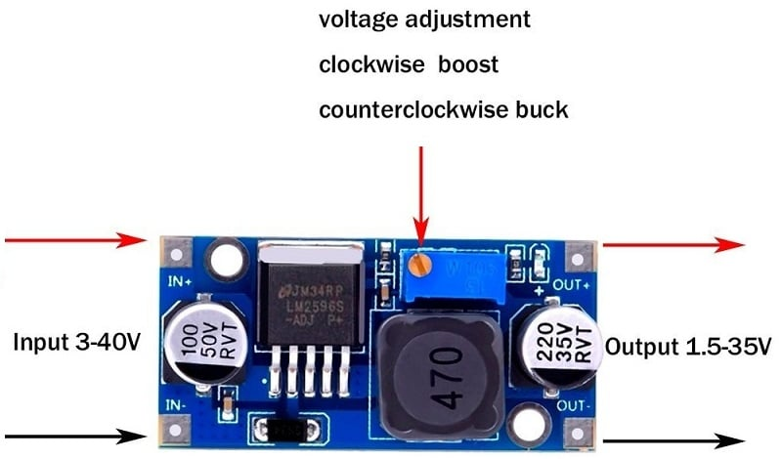
MODULE DESCRIPTION
LM2596S Specification
Output Voltage (V): | 1.5-35V(Adjustable)
Output Current (A): | Rated current is 2A, maximum 3A(Additional heatsink is required)
Switching Frequency (KHz) | 150KHz
Conversion efficiency | 92%(highest)
Load Regulation | ± 0.5%
Voltage regulation (U) | ± 0.5%
Dynamic Response Speed | 5% 200uS
Dimensions (L x W x H) mm | 45*20*14mm(L*W*H)
Operating Temperature (°C): | Industrial grade (-40 to +85 )
Fig. LM2596S with SMD LED DC-DC Step-Down Power Supply

Slide 16
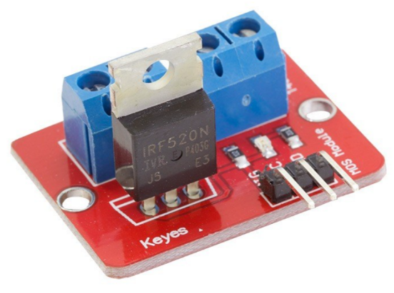
MODULE DESCRIPTION
IRF520 MOSFET Specification
Operating Voltage (V): | 3.3 to 5
Model No.: | IRF520
Max. Output Load | Current: <5 (1A above need to add heat sink), Voltage: 0 to 24
Platform | Arduino, MCU, ARM, Raspberry PI
Length (mm): | 34
Width (mm): | 25
Height (mm): | 18
Weight (g): | 10
Fig. IRF520 MOSFET Driver Module

Slide 17
METHODOLOGY
The ventilator system is designed to monitor and assist with oxygen supply by operating in four key phases: Real-time Monitoring, Adaptive Control, Emergency Alerting, and Power Management.
When the system is powered on, it initializes all necessary components, including the LCD display, GSM module, MOSFET (motor control), and Pulse Oximeter sensor.A message appears on the LCD screen indicating that the system is starting up.
If the Pulse Oximeter sensor fails to initialize, the system halts further execution and remains in an infinite loop to prevent incorrect operation. If everything is initialized successfully, the system proceeds to continuous monitoring.
The system repeatedly reads oxygen saturation (SpO₂) and heart rate from the Pulse Oximeter sensor. These values are displayed on the LCD screen, updating every second.This ensures that real-time readings are available for both the user and the ventilator control mechanism.
The ventilator motor’s speed is adjusted dynamically based on the oxygen saturation level. If the oxygen level is within a safe range (between 90% and 100%), the motor runs at a moderate speed.

Slide 18
METHODOLOGY
If the oxygen level starts dropping below 100%, the motor speed gradually increases to compensate for the decreasing oxygen levels. This adjustment is done in such a way that lower oxygen levels result in higher ventilator speeds to help the patient breathe more efficiently.
If the oxygen saturation level falls below 90%, the system identifies this as a critical condition. The buzzer is activated to provide an audible warning to nearby individuals. This alerts caregivers or medical personnel that the oxygen level has dropped to an unsafe level.
If more than 10 seconds have passed since the system started and an alert has not been sent before, an emergency SMS is triggered. The LCD screen displays a message indicating that an alert is being sent.
The system communicates with the GSM module to send a text message to a pre-configured phone number, warning about the detected low oxygen levels. To prevent multiple unnecessary alerts, the system ensures that only one message is sent per critical event.

Slide 19
METHODOLOGY
Once the oxygen saturation level rises back above 90%, the system turns off the buzzer. The system continues to monitor the patient, ensuring that oxygen levels remain stable. If the oxygen level stabilizes above 92% for a prolonged period, the system can reset the alert mechanism, allowing future warnings if necessary
The entire process of monitoring, adjusting the ventilator, and triggering emergency alerts continues indefinitely. The system ensures that real-time readings are always displayed, the ventilator adjusts to changing conditions, and alerts are sent only when necessary.

Slide 20
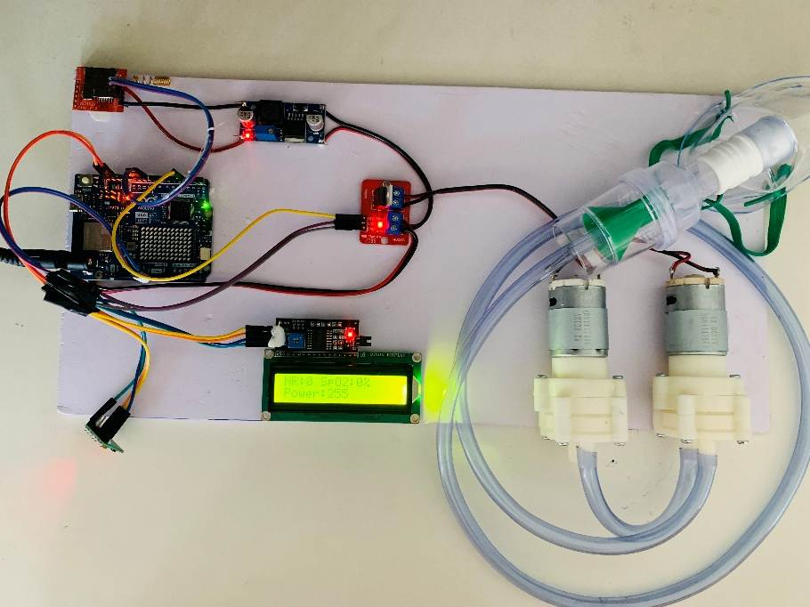
IMPLEMENTATION
The system initializes components, including the LCD, MAX30100 sensor, MOSFET module, and GSM module.
Fig: System initializes components.

Slide 21
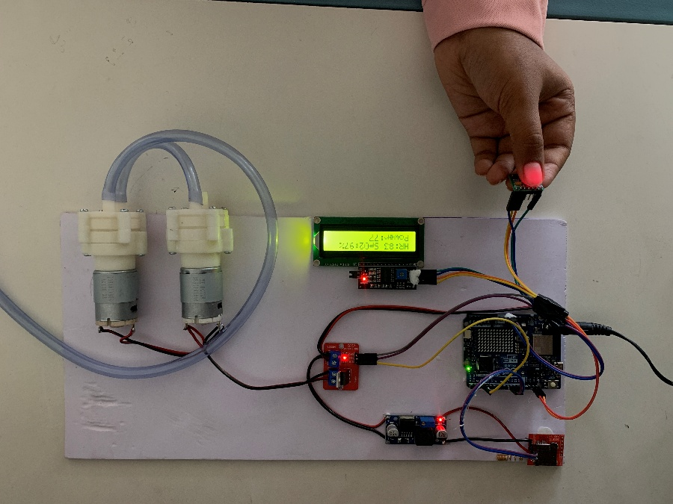
IMPLEMENTATION
It continuously monitors SpO₂ and heart rate, displaying values on the LCD and adjusting the ventilator speed based on SpO₂ levels
Fig: Continuously monitors SpO₂ and heart rate.

Slide 22
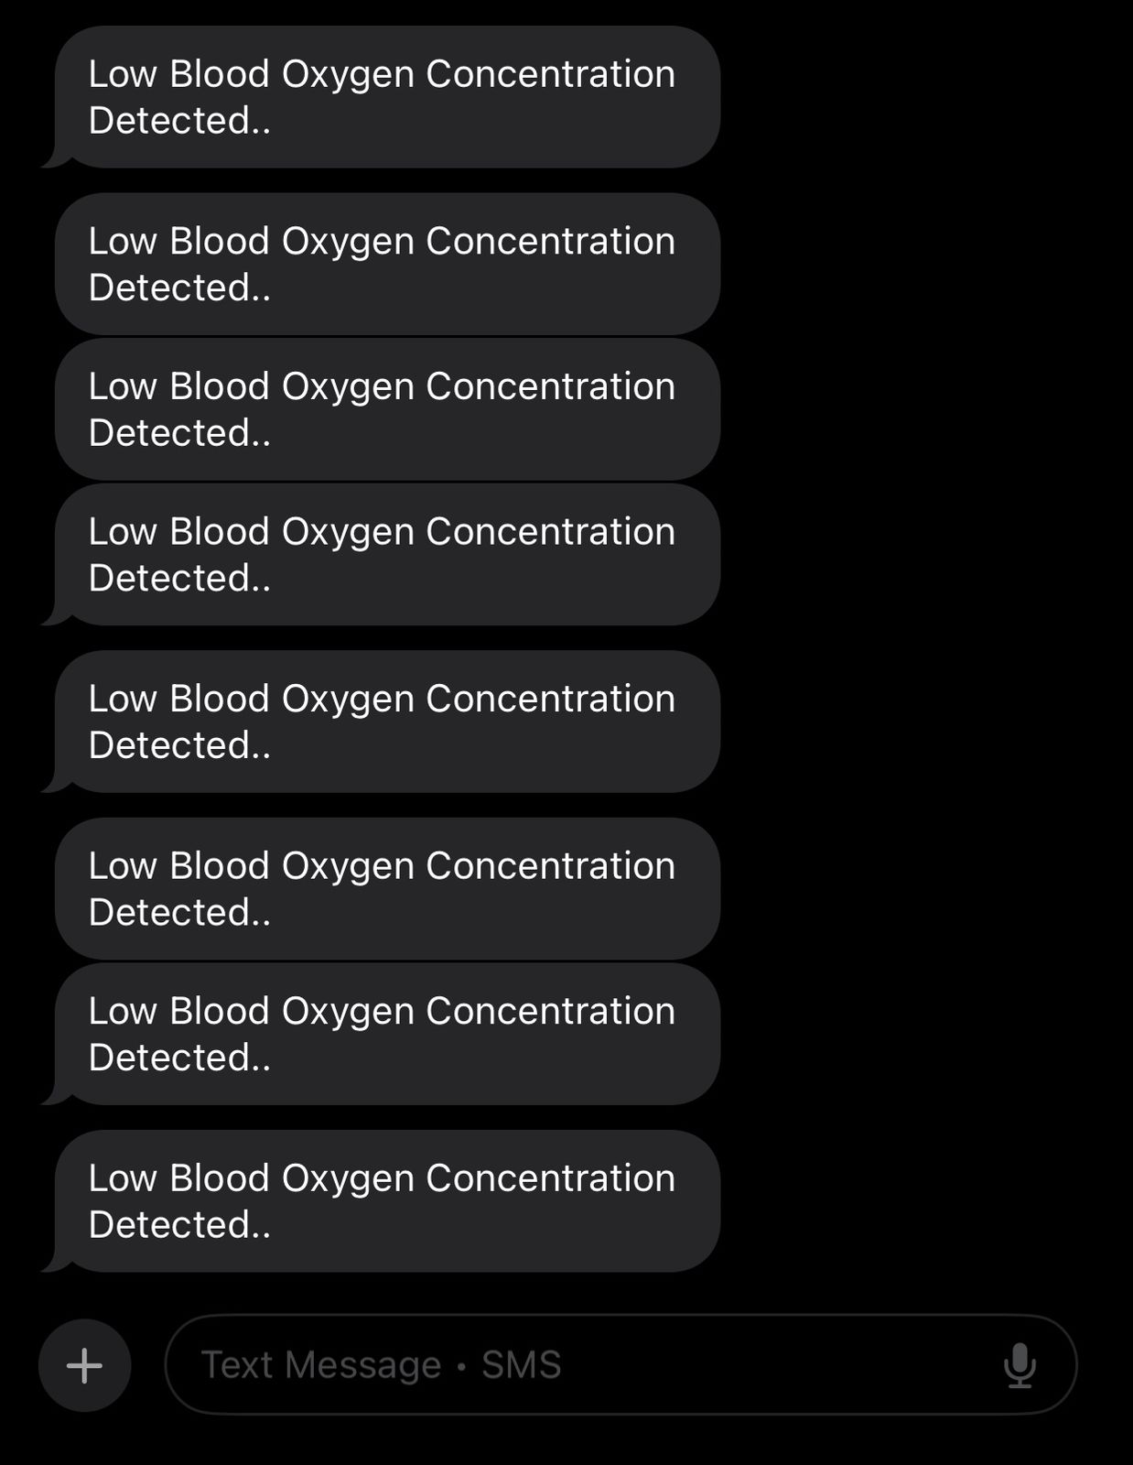
IMPLEMENTATION
If SpO₂ drops below 90% for over 10 seconds, an emergency SMS alert is sent via the GSM module. The system runs in a loop, ensuring real-time monitoring and adaptive ventilator control
Sending alert SMS
Received alert SMS

Slide 23
CONCLUSION
The low-cost ventilator system provides a simple yet effective solution for automated respiratory support. By integrating SpO2 monitoring, fuzzy logic-controlled ventilation, and GSM-based emergency alerts, the system enhances patient care and reduces dependency on expensive hospital ventilators.
Its affordability, portability, and automation make it an ideal solution for healthcare facilities in developing regions and emergency scenarios. Future improvements, such as IoT connectivity and AI-driven analytics, could further enhance its functionality and adaptability.

Slide 24
CHALLENGES
Limited Battery Backup – The system relies on a battery-powered setup, which means it requires a reliable power source or frequent recharging to ensure continuous operation. If the battery depletes, the ventilator may stop functioning, posing a risk to the patient.
Dependency on GSM Network – The emergency alert system depends on GSM network availability. In areas with weak or no network coverage, the system may fail to send critical SMS alerts, delaying emergency response.
Basic Ventilation Support – This system provides only essential ventilatory assistance by adjusting motor speed based on SpO₂ levels. It may not be suitable for patients with severe respiratory conditions requiring advanced ventilation modes, such as pressure-controlled or volume-controlled ventilation.
Sensor Limitations – The MAX30100 pulse oximeter sensor can be affected by motion artifacts, improper finger placement, or poor circulation, leading to inaccurate SpO₂ readings. This could result in incorrect ventilator adjustments or missed emergency alerts.

Slide 25
ADVANTAGES
Low Cost – The system is built using affordable and easily available components, making it a cost-effective solution for resource-limited regions where access to advanced medical equipment is scarce.
Automated Operation – The ventilator functions independently, reducing the need for constant manual adjustments and medical supervision, which is especially useful in emergency situations or understaffed healthcare settings.
Fuzzy Logic Control – The system intelligently adjusts the ventilator motor speed based on SpO₂ levels, providing smooth and adaptive control rather than abrupt changes, ensuring patient comfort and efficiency.
Real-Time Monitoring – Continuous measurement and display of SpO₂ and heart rate data on an LCD screen enable caregivers to monitor patient conditions instantly, allowing for timely interventions.
Remote Alert System – In case of a critical drop in SpO₂ levels, the system automatically sends an emergency SMS notification to predefined medical personnel, ensuring a rapid response to potential health crises.

Slide 26
FUTURE ENHANCEMENT
Integration of Advanced Ventilation Modes: Future iterations of the system can incorporate support for advanced ventilation techniques such as pressure-controlled, volume-controlled, and BiPAP/CPAP modes. This would make the ventilator suitable for patients with more severe respiratory conditions and extend its use in intensive care settings.
Improved Sensor Accuracy and Redundancy: Upgrading to more accurate and robust biomedical sensors—such as the MAX30102 or medical-grade pulse oximeters—can reduce the impact of motion artifacts and environmental interference. Additionally, incorporating redundant sensors can increase reliability by cross-verifying vital data.
Battery Health Monitoring and Solar Charging Support: Future versions could include a battery management system (BMS) to monitor battery health and ensure safe charging/discharging cycles. Integration of solar charging options would further extend the system’s usability in off-grid or rural areas.

Slide 27
FUTURE ENHANCEMENT
Modular and Scalable Design: A modular design would allow easy customization and upgrades—for instance, switching between different sensor types or power sources—making the system more adaptable for different use cases and environments.

Slide 28
APPLICATIONS
Area | Application
Emergency Respiratory Support | Assists patients in respiratory distress or failure.
Pandemic Preparedness | Helps in managing ventilator shortages during outbreaks like COVID-19.
Post-Surgical Care | Provides breathing support for recovering patients.
Home Healthcare | Supports patients with chronic respiratory conditions who require assisted breathing.
Military and Field Hospitals | Supports injured soldiers in remote and combat zones.
Medical Schools and Research Institutions | Used for medical training and ventilator research.

Slide 29

Any Queries??

Slide 30


Just off NH 766, Nanjanagudu taluk, Mysore district - 571302
Thank You!
Department of Electronics & Communication Engineering

